Slide 1
Lending Club
Loan Approval Optimization
Michael Son

Slide 2
Problem
Task: Loan approval optimization
Strategy
In-depth feature analysis
Data-driven binary classification
Key Resource: https://data.world/jaypeedevlin/lending-club-loan-data-2007-11

Slide 3
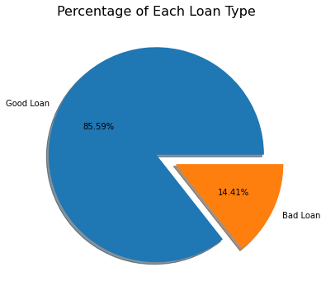
Data Analysis
Imbalanced data
New features
fico_range_avg
loan_status → loan_type
loan_type binary classification

Slide 4
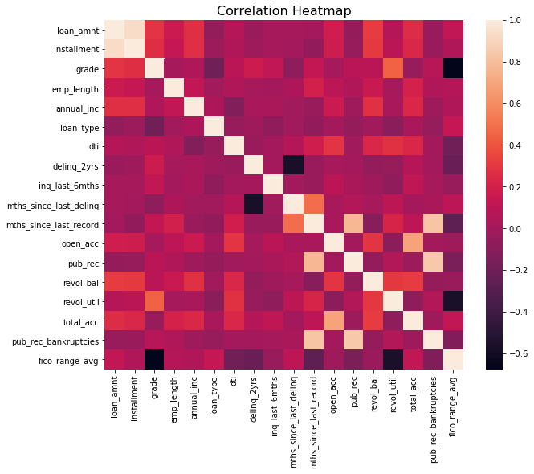
Data Analysis
Intrinsically linked features
Notable loan_type correlations
grade
fico_range_avg
revol_util
inq_last_6mths

Slide 5
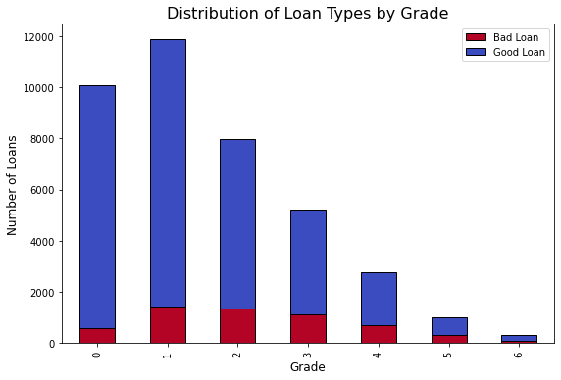
Data Analysis

Slide 6
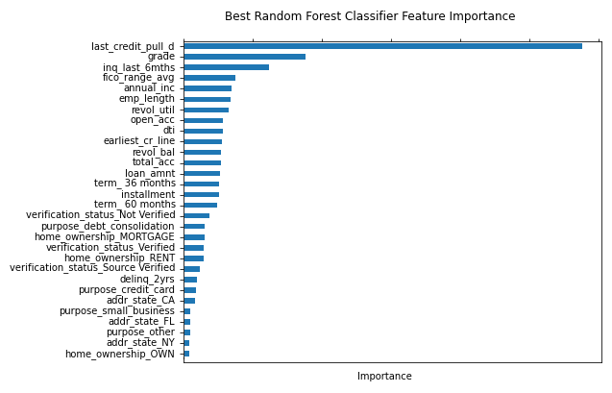
Modeling
Random Forest Classifier
Primary features of importance
last_credit_pull d
grade
inq last 6mths

Slide 7
Conclusion
Best model: Random Forest Classifier
Prospective improvements
Data update (current data: 2007-2011)
Feature engineering
Hyperparameter tuning

